Slide 1
Bode Design and Lead, Lag, & PID Compensators
Discrete-time compensator design using Bode plots
Z-plane Bode plotting rule of thumb
Lead and lag compensators
  Example
PID control
  P, D, PD, I, PI control

Slide 2
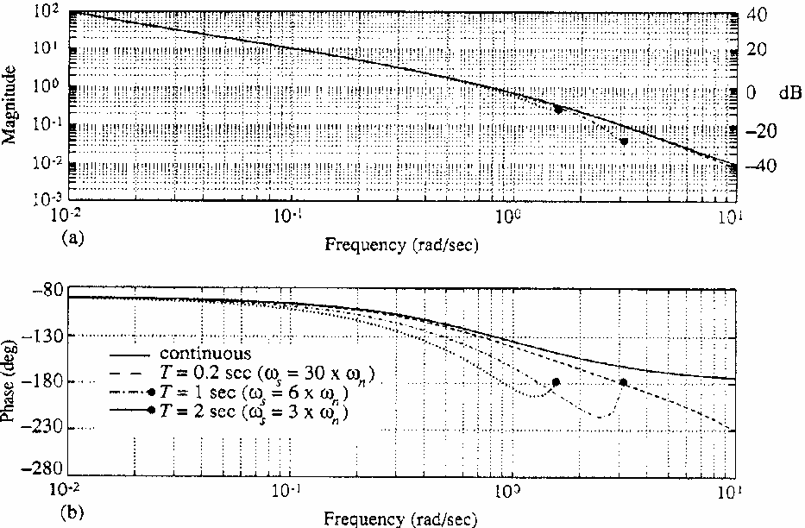
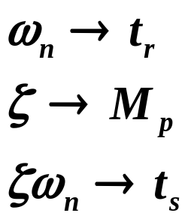
Discrete-Time Compensator Design using Bode Plots
What is correspondence of previous design parameters with quantities determined from Bode plots?
For a 2nd-order continuous-time system w/o finite zeros:
Im(s)
Im(z)
Re(s)
Re(z)
1

Slide 3
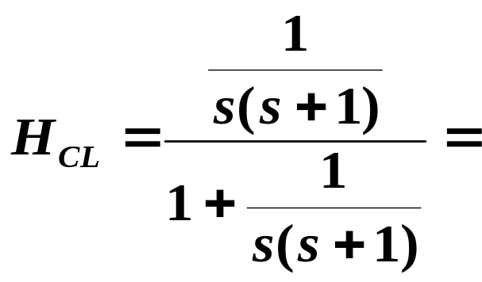
Revisiting Example 7.8 yet again:
See Figure 7.22 of text.

Slide 4
Z-Plane Bode Plotting Rule of Thumb
Equivalent idea of “breakpoint” in plotting discrete Bode plots:
  Magnitude will change slope at a frequency when ωT, the angular position on the unit circle in radians, has the same value as the fractional distance of the singularity on the real axis to z = +1
    Rule of thumb accurate for ωT relatively small.
Im(z)
Re(z)
1

Slide 5
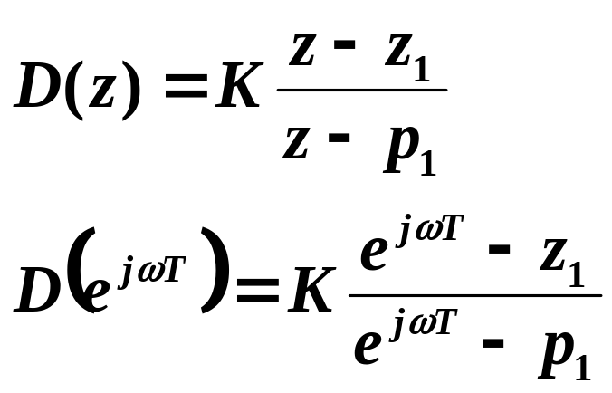

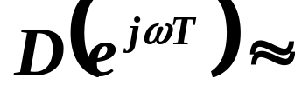
For instance,
For small

Slide 6
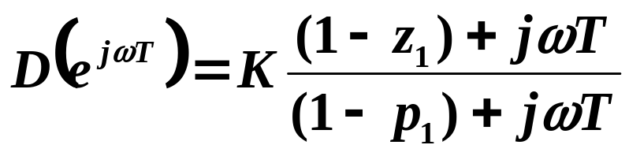
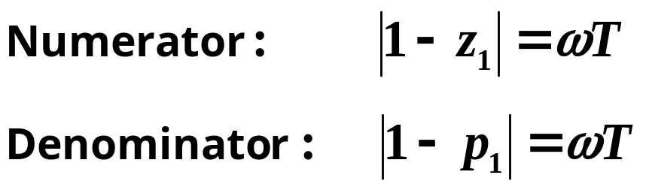


Breakpoints for numerator and denominator occur at ω where the real and imaginary parts are equal:
Very accurate for
Moderately accurate for

Slide 7
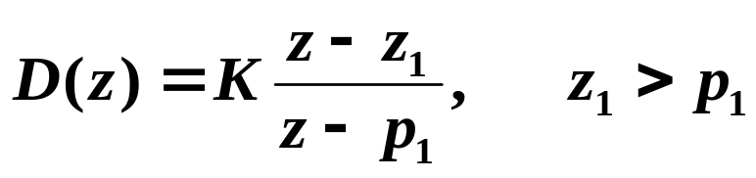

Lead Compensation
Lead and Lag Compensators
Im(z)
Re(z)
1
Im(z)
Lag Compensation
Re(z)
1
Im(z)
Re(z)
1

Slide 8





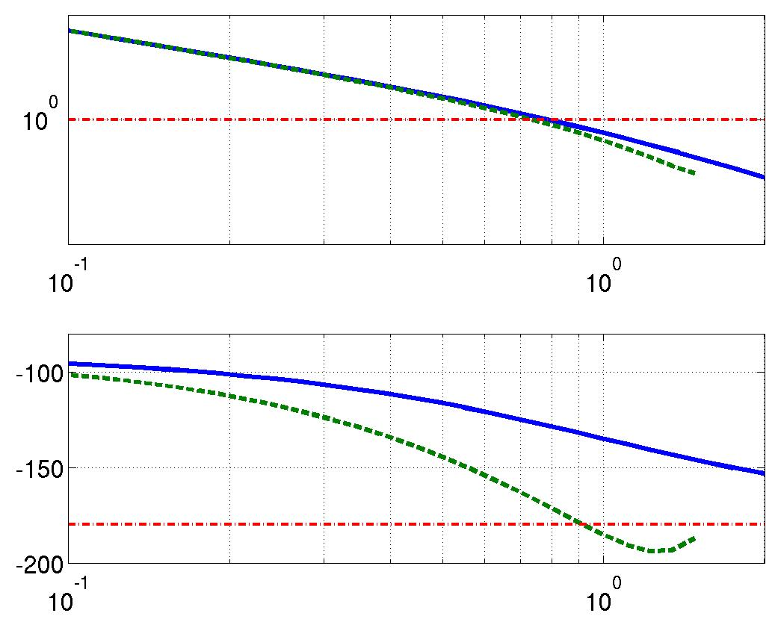
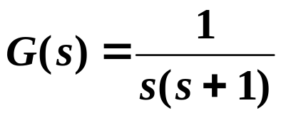


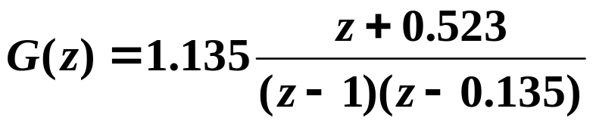

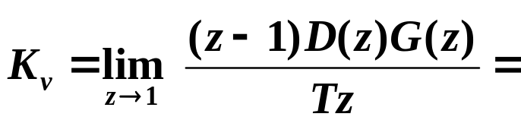


Example
Σ
G(s)
G(z)
T = 2 sec:
Uncompensated (D(z) = 1):
Frequency (rad/s)
Type 1 system:
to unit ramp

Slide 9
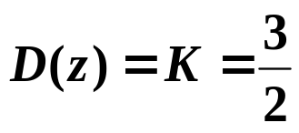
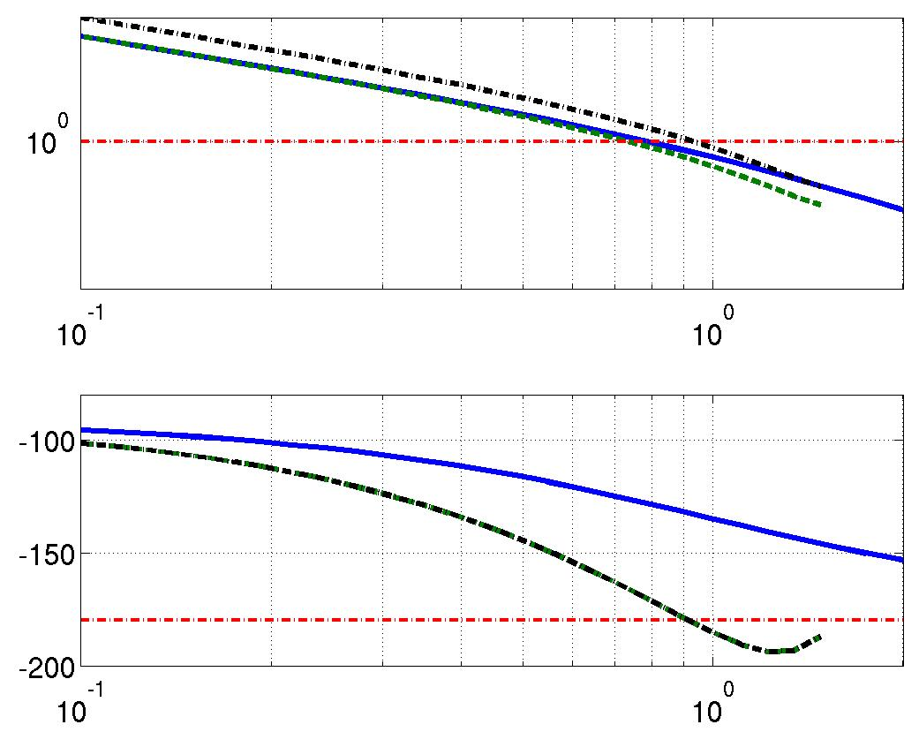


Design a compensator so to unit ramp < 2/3.
If
Are there any problems with doing this?
G(s)
G(z)
1.5 G(z)
Useful MATLAB command: margin
Frequency (rad/s)

Slide 10
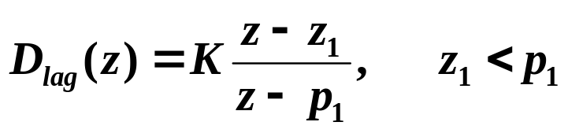
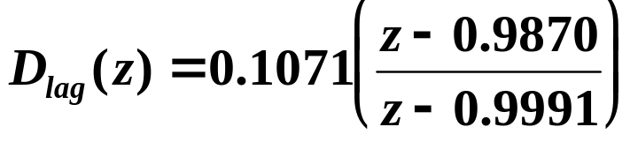
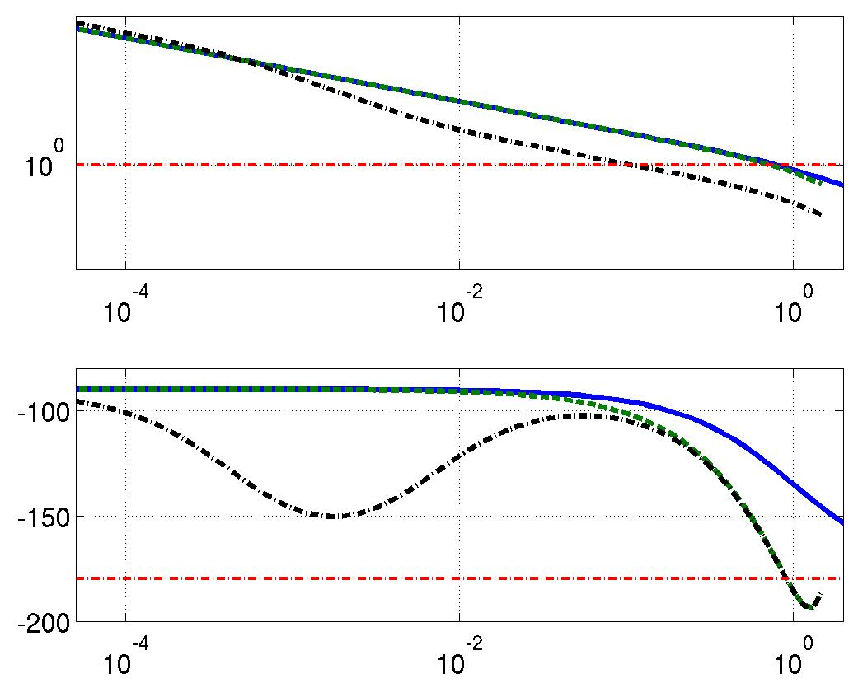
Design a lag compensator to achieve to unit ramp < 2/3.
Choose pole at 1 - ωT such that
Choose zero at 1 - ωT such that
G(s)
Im(z)
G(z)
Re(z)
D_{lag}(z)G(z)
1
Frequency (rad/s)

Slide 11
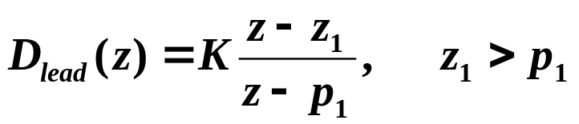
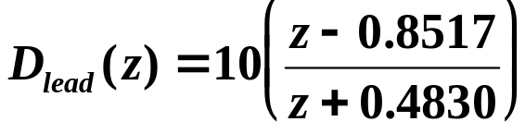
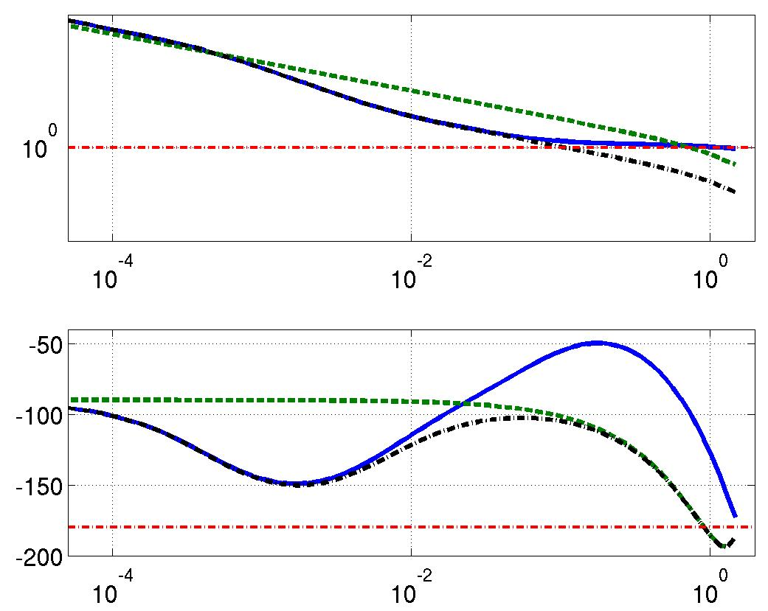
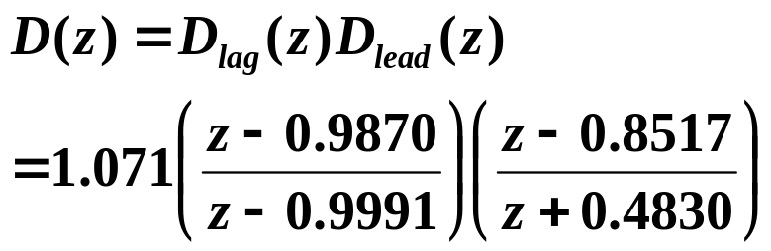
Design a lead compensator to achieve t_{r} < 2 sec and M_{p} < 40%.
Choose pole at 1 - ωT such that
Choose zero at 1 - ωT such that
D(z)G(z)
G(z)
D_{lag}(z)G(z)
Im(z)
Re(z)
1
Frequency (rad/s)

Slide 12






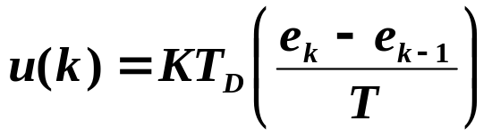
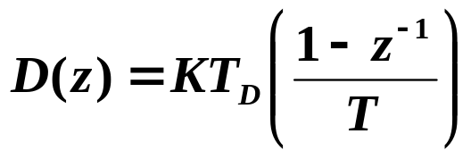
P and D Control
Σ
P: Proportional Control
Continuous:
Discrete:
Increases K_{p} or K_{v} (decreases e_{ss} ), but can destabilize the system.
Im(s)
D: Derivative Control
Re(s)
Continuous:
Discrete: approximate derivative using 1st-order difference
Im(z)
Re(z)
1
Increases damping (decreases overshoot).

Slide 13
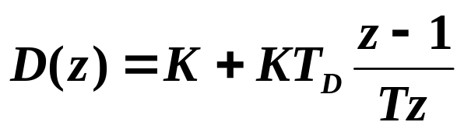
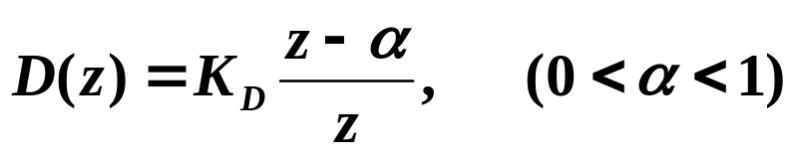
PD Control
Im(z)
Re(z)
1

Slide 14
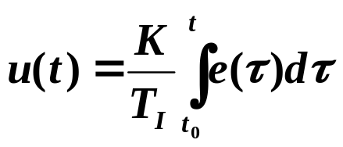
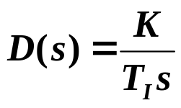
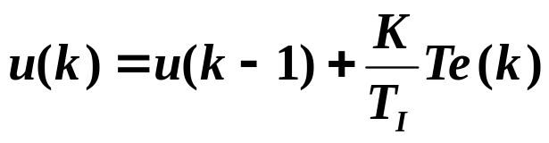
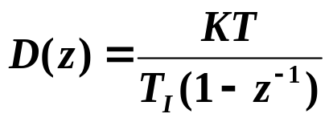
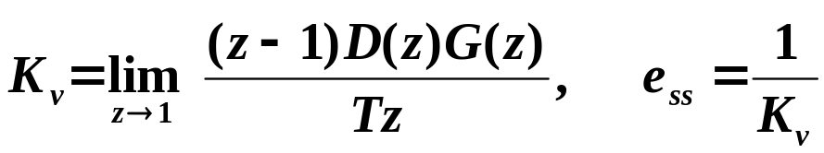
I: Integral Control
Im(s)
Continuous:
Discrete: one way is to approximate integral using
backward rectangular rule
Re(s)
Im(z)
Re(z)
1
Decreases e_{ss}.

Slide 15
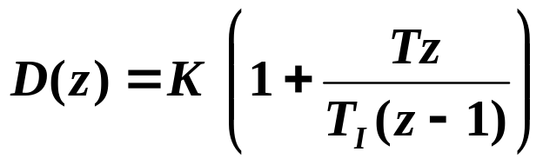
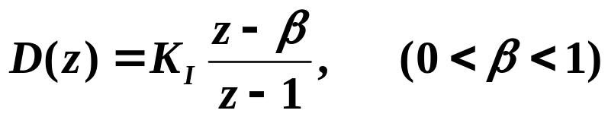
PI Control
Im(z)
Re(z)
1

Slide 16
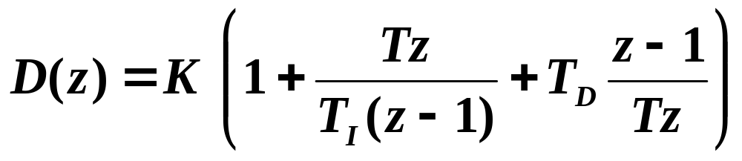
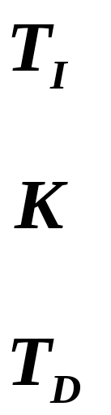
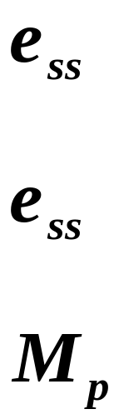
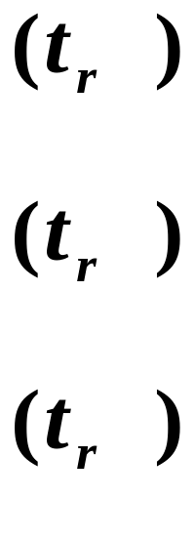
PID Control
In general:

